Slide 1

29th ANNUAL GENERAL MEETING
AGENCY FEE PRESENTATION

Slide 2

PRESENTATION OVERVIEW
01
05
LEGISLATIVE MANDATE
AGENCY FEE DISTRIBUTION
02
06
TOTAL AGENCY FEE PAYERS
AGENCY FEE GOVERNANCE AND ASSURANCE
03
07
AGENCY FEE PAYERS BY PROVINCE
PROVISIONS OF PSCBC RESOLUTION 1 OF 2005
04
08
AGENCY FEE INCOME
DETERMINATION- RESOLUTION 1 OF 2011

Slide 3
LEGISLATIVE MANDATE
The following legislation and collective agreements, regulate the payment of agency fees:
Provisions of section 25 of the Labour Relations Act (66 of 1995) as amended
Agency Shop Agreement- PSCBC Resolution 1 of 2005
Agency Fee Agreement- PSCBC Resolution 2 of 2010
Agency Fee Agreement PSCBC Resolution 1of 2011

Slide 4
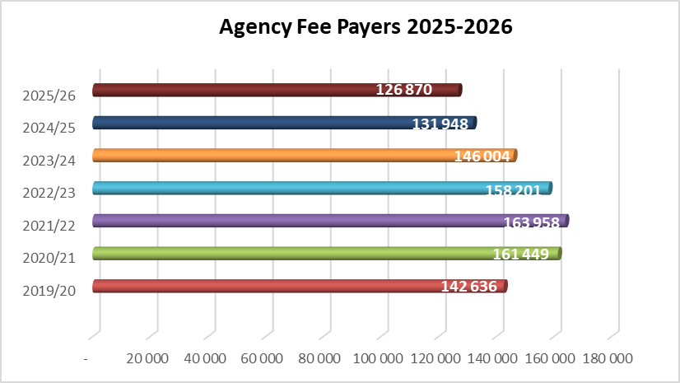

TOTAL AGENCY FEE PAYERS
Number of Agency Fee payers over the past seven financial years.
12.2.1
Promotion
12.2.2
12.2.4
Financial mpication

Slide 5
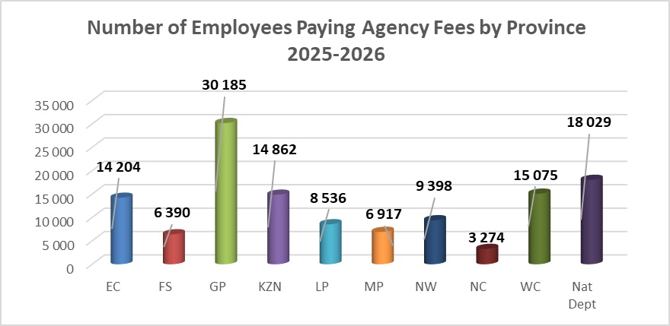
AGENCY FEE PAYERS BY PROVINCE
Gauteng accounts for approximately 24% of all Agency Fee payers, followed by National Departments (14%), Western Cape (12%) and KwaZulu Natal (12%) .
12.2.1
Promotion
12.2.4
Financial mpications

Slide 6
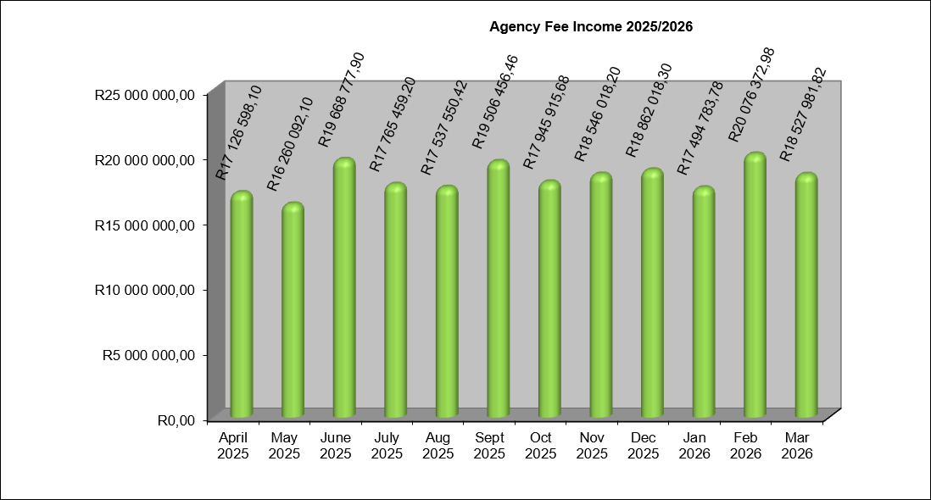
AGENCY FEE INCOME
Total Agency Fee income during 2025/26 amounted to R219.3 million, average monthly income is approximately R18.3 million, February 2026 was the highest at R20.1 million.
12.2.1
Promotion
12.2.4
Financial mpications

Slide 7
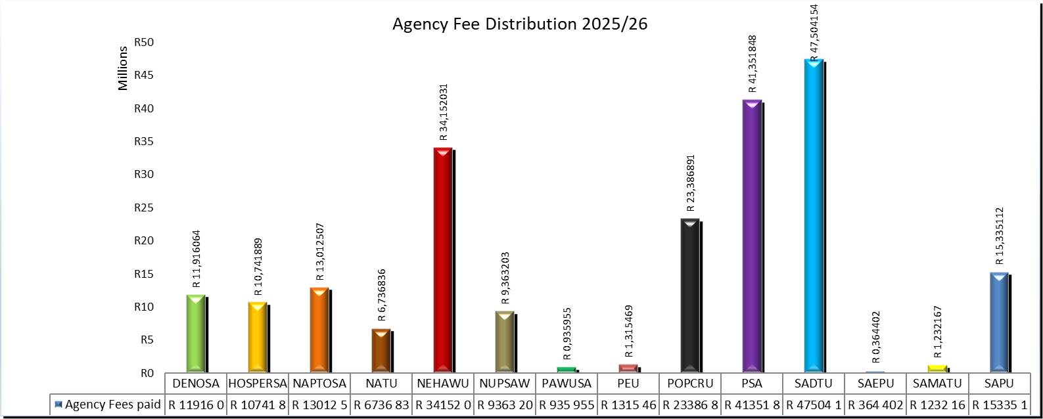
AGENCY FEE DISTRIBUTION
Agency Fees are distributed proportionally amongst admitted trade unions in accordance with PSCBC Vote Weight determination.
12.2.1
Promotion
12.2.4

Slide 8
AGENCY FEE GOVERNANCE AND ASSURANCE
Agency Fees are deducted through PERSAL and PERSON systems.
Monthly remittance advice received from National Treasury.
A separate Agency Fee Trust Account maintained by the Council.
Monthly proportional distributions performed as per Vote Weight determination.
Quarterly Finance Committee oversight.
Agency Fee Trust account is independently audited annually.

Slide 9
PROVISIONS OF PSCBC RESOLUTION 1 OF 2005
Each trade union must open a separate bank account for the purpose of this agreement and the money in that account may be used only for –
Prohibited use of Agency Fees –
Provisions of PSCBC Resolution 1 of 2005
Collective bargaining,
Dispute resolution,
Training of trade union representatives
Political party contributions,
Election campaign funding, and/or
Any expenditure that does not advance or protect the socio-economic interests of employees.
The trade unions must keep books and records of their respective bank accounts in accordance with generally accepted accounting practices, including statements of income and expenditure and the balance sheets indicating the assets, liabilities and financial standing of the account.

Slide 10
PROVISIONS OF PSCBC RESOLUTION 1 OF 2005 Continued…
The bank accounts must be audited annually, which audited accounts will be open to any party to the Council, or any employee, for inspection.
The agreement requires a determination by the General Secretary as per the provisions in clause 3.3 on the highest amount payable for subscription by a member belonging to a Trade Union admitted to the PSCBC.
The amount payable for the agency fee must be equivalent to the highest amount for such subscription. The annual adjustment is also furthermore allowed for in terms of section 25(3) (b) (iii) of the Labour Relations Act 66 of 1995 (as amended).

Slide 11
DETERMINATION- RESOLUTION 1 OF 2011
From the information received, the highest amount payable for subscription by a member belonging to a trade union admitted to the PSCBC, is NAPTOSA with a subscription fee amount of R132.50.
Therefore, the agency fee amount payable will be adjusted from R125.50 to R132.50 (5.58% increase) per month, wef 01 July 2026.

Slide 12

Thank You!!

